Slide 1
Term Project template
Group#26
Names
Sawsan Awad (300327224)
Sondos Ali (300327219)
Toka Mostafa (300327284)

Slide 2
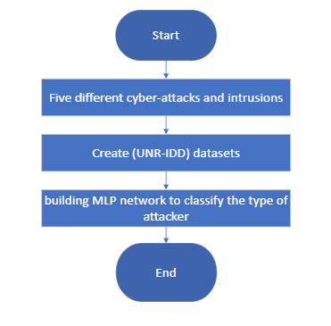
Problem’s overview

Slide 3
Dataset’s overview (EDA)
No Null values found
Checking for instance of each class
There are several outliers
High variance, mean, max.

Slide 4
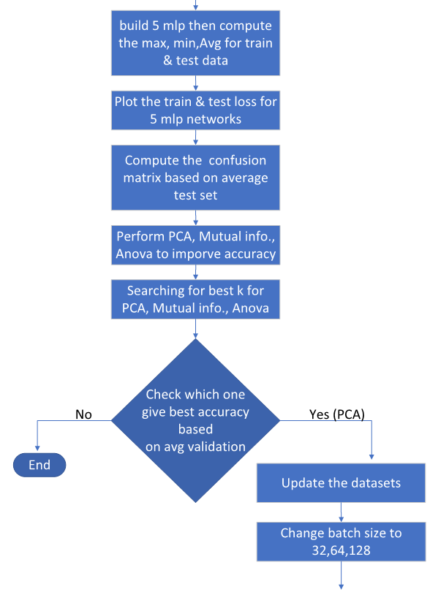
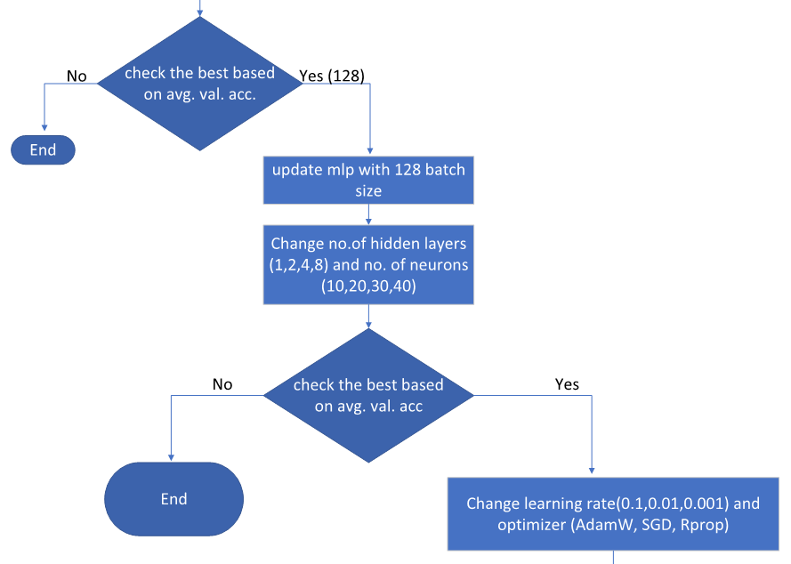
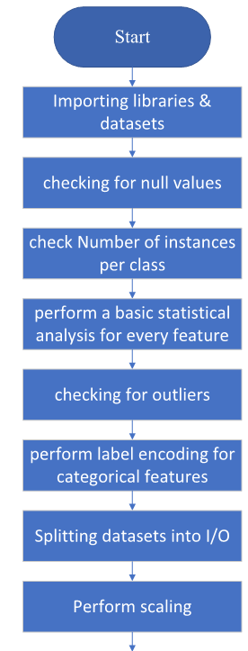
Flowchart

Slide 5
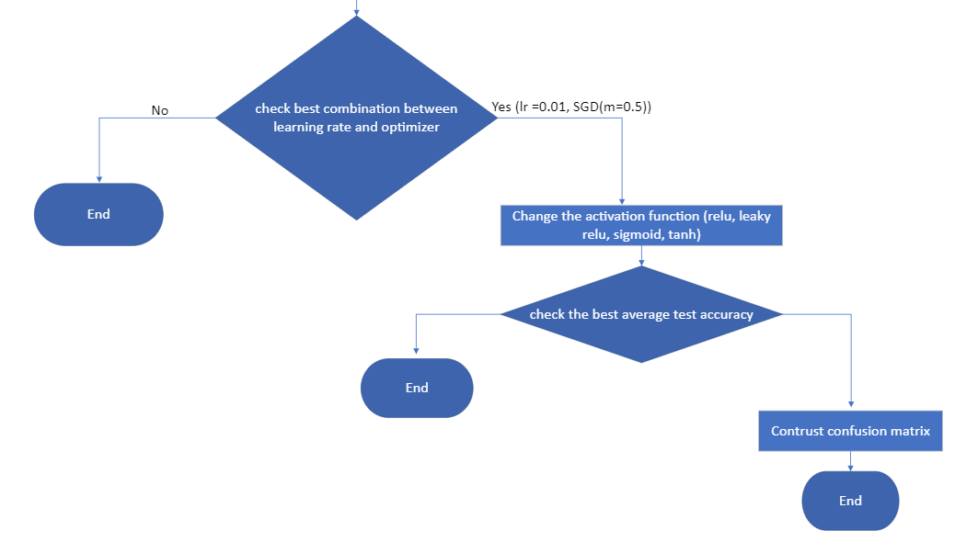
flowchart

Slide 6
Obtain a baseline performance
After 5 rounds of multi-layer perceptron
Max Train acc | Max Test acc | Min Train acc | Min Test acc | Avg Train acc | Avg Test acc
73.19% | 74.87% | 55.89% | 59% | 69.13% | 71.02%

Slide 7
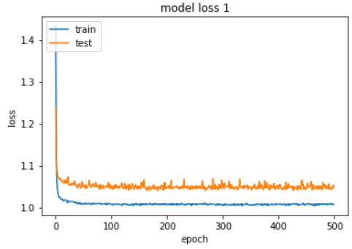
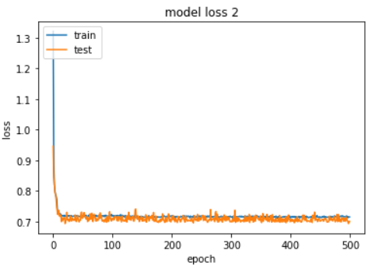
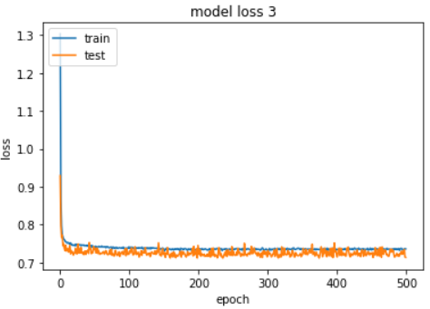
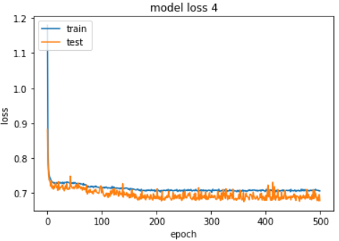
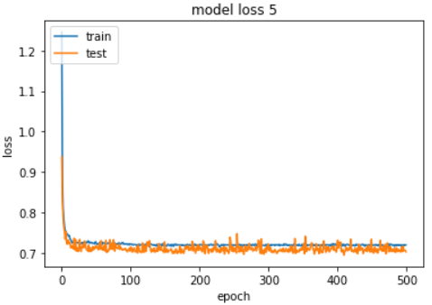
The training and testing losses vs. the number of epochs

Slide 8
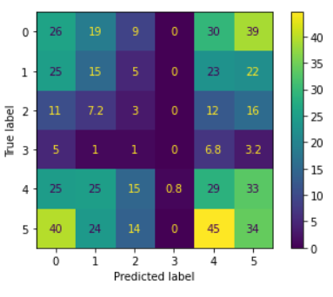
Average confusion matrix
Average accuracy: 19%
Very low

Slide 9
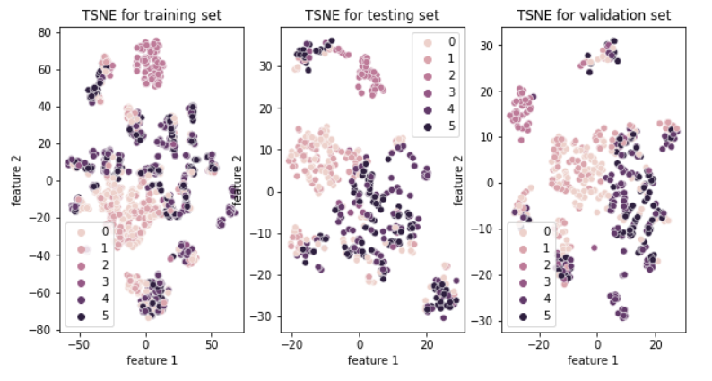
TSNE plot

Slide 10
Compare dimensionality reduction to feature selection
PCA (Dimensionality reduction)
Best k = 20 features Accuracy = 75.22% Winner
Mutual information (Feature selection)
Best k = 19 features Accuracy = 74.68%
Anova (Feature selection)
Best k = 17 features Accuracy = 74.86%

Slide 11
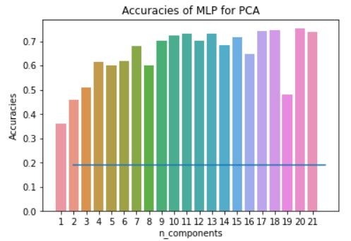
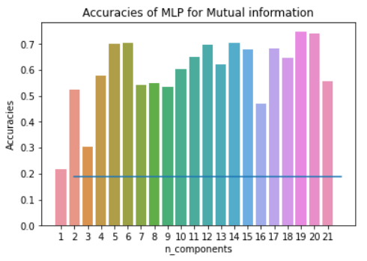
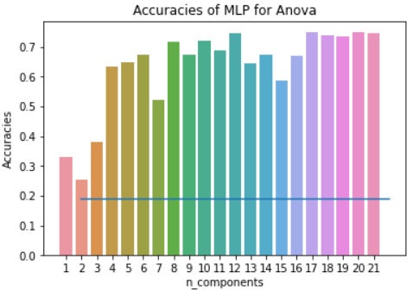
Accuracies of feature engineering

Slide 12
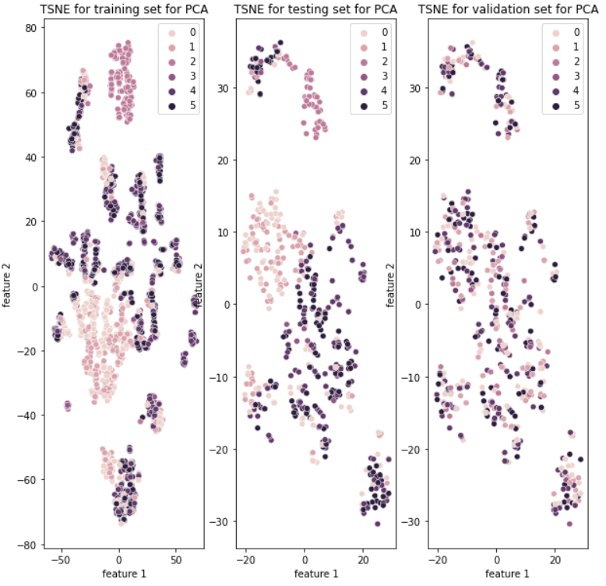
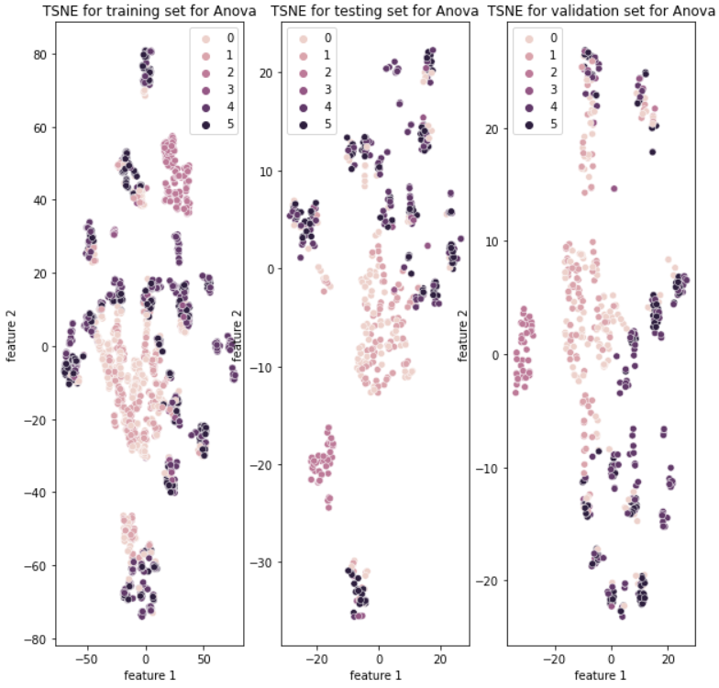
TSNE plot for PCA and Anova

Slide 13
Vary the MLP parameters

Slide 14
Vary the MLP parameters (Batch size)
Batch 32 |  |  |  |  |  | Batch 64 |  |  |  |  |  | Batch 128
Max Train acc | Max Test acc | Min Train acc | Min Test acc | Avg Train acc | Avg Test acc | Max Train acc | Max Test acc | Min Train acc | Min Test acc | Avg Train acc | Avg Test acc | Max Train acc | Max Test acc | Min Train acc | Min Test acc | Avg Train acc | Avg Test acc
75% | 75% | 41.8% | 40.6% | 60.8% | 58.6% | 67.5% | 68.98% | 25.2% | 26.6% | 52.8% | 53.5% | 61.2% | 63.1% | 27.6% | 30.3% | 44.1% | 43.3%

Slide 15
Hidden layers vs. neurons/layer
 | One hidden layer |  |  |  |  |  | Two hidden layers |  |  |  |  |  | Four hidden layers |  |  |  |  |  | Eight hidden layers
#of neurons | Max Train acc | Max Test acc | Min Train acc | Min Test acc | Avg Train acc | Avg Test acc | Max Train acc | Max Test acc | Min Train acc | Min Test acc | Avg Train acc | Avg Test acc | Max Train acc | Max Test acc | Min Train acc | Min Test acc | Avg Train acc | Avg Test acc | Max Train acc | Max Test acc | Min Train acc | Min Test acc | Avg Train acc | Avg Test acc
10 | 75% | 73.6% | 43.1% | 40.6% | 59.9% | 58.1% | 67.2% | 67.7% | 26.3% | 24.8% | 41.8% | 42.4% | 78.2% | 77.9% | 20.7% | 21.4% | 50.3% | 49.2% | 67.3% | 67.7% | 21.7% | 22.5% | 42.2% | 42.1%
20 | 73.2% | 73.3% | 43.3% | 48.5% | 57% | 56.5% | 71.4% | 73.3% | 34.2% | 34.6% | 55.4% | 55.9% | 72.1% | 69.7% | 28.6% | 25.3% | 49.9% | 48.7% | 66.7% | 56.5% | 21.6% | 22.1% | 47.4% | 44.3%
30 | 70.4% | 70.4% | 37.9% | 40.1% | 62.4% | 62.7% | 71.9% | 71.4% | 30.1% | 31.9% | 56.7% | 56.3% | 72.9% | 70.4% | 39.4% | 37.1% | 54.2% | 50.2% | 66.5% | 59.3% | 39.9% | 40.8% | 53.5% | 50.8%
40 | 70.2% | 70.4% | 61.3% | 59.9% | 66.2% | 65% | 68.2% | 69.3% | 38.3% | 35.7% | 52.3% | 51.2% | 71.8% | 71.5% | 36.9% | 40.1% | 55.1% | 56% | 69.8% | 61.3% | 52.3% | 49% | 59.3% | 54%

Slide 16
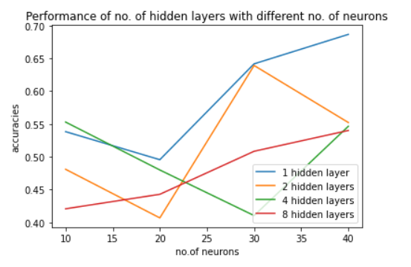
Plot the number of neurons vs the avg test accuracy

Slide 17
Learning rate and different optimizers
 | Learning rate = 0.1 |  |  |  |  |  | Learning rate = 0.01 |  |  |  |  |  | Learning rate = 0.001
Optimizer | Max Train acc | Max Test acc | Min Train acc | Min Test acc | Avg Train acc | Avg Test acc | Max Train acc | Max Test acc | Min Train acc | Min Test acc | Avg Train acc | Avg Test acc | Max Train acc | Max Test acc | Min Train acc | Min Test acc | Avg Train acc | Avg Test acc
AdamW | 56% | 56.1% | 42.9% | 39.3% | 49.9% | 47.2% | 66.4% | 64.9% | 45.5% | 44.6% | 57.1% | 55.1% | 58.5% | 54.4% | 33.5% | 32.3% | 47.9% | 45.3%
SGD (m=0.1) | 58.1% | 52.6% | 22% | 21.7% | 48.1% | 44.8% | 58.9% | 58.3% | 26.6% | 22.6% | 40.4% | 37.9% | 40.7% | 37.8% | 25.1% | 22.1% | 28.6% | 26.8%
SGD (m=0.5) | 55.4% | 54% | 27.2% | 24.2% | 40.6% | 39.4% | 54.2% | 48.3% | 21.4% | 21.7% | 34.2% | 31.3% | 35.4% | 39.6% | 21.4% | 21.7% | 26.9% | 27.6%
SGD (m=0.9) | 60.7% | 56.1% | 25.4% | 22.6% | 44.1% | 40.4% | 59.2% | 54% | 22.9% | 22.6% | 35.2% | 32.9% | 62.9% | 61.3% | 24.8% | 28.3% | 48.5% | 48%
Rprop | 40.8% | 38.7% | 21.4% | 21.7% | 26.9% | 25.5% | 82.9% | 75% | 51.4% | 48.8% | 63.6% | 59.2% | 65.1% | 59.5% | 21.4% | 21.7% | 47.6% | 45.8%

Slide 18
Activation functions
Relu |  |  |  |  |  | Leaky relu |  |  |  |  |  | Sigmoid |  |  |  |  |  | Tanh
Max Train acc | Max Test acc | Min Train acc | Min Test acc | Avg Train acc | Avg Test acc | Max Train acc | Max Test acc | Min Train acc | Min Test acc | Avg Train acc | Avg Test acc | Max Train acc | Max Test acc | Min Train acc | Min Test acc | Avg Train acc | Avg Test acc | Max Train acc | Max Test acc | Min Train acc | Min Test acc | Avg Train acc | Avg Test acc
66.1% | 62.2% | 25.4% | 23.4% | 41.1% | 38.1% | 65.6% | 65.2% | 25.4% | 22.6% | 42.3% | 39.9% | 25.4% | 22.6% | 21.4% | 21.7% | 24.6% | 22.5% | 61.9% | 58.8% | 46.4% | 42.6% | 54.3% | 51.3%

Slide 19
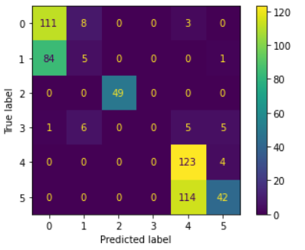
Confusion matrix

Slide 20
Conclusion
We applied the MLP network in several stages.
First, we perform baseline MLP then we applied several hyperparameters tuning
Hyperparameter tuning is very powerful transforming the accuracy from 19% to 51.4%
Make a combination of several hyperparameters to choose the best

Slide 21

Thank you

